Slide 1
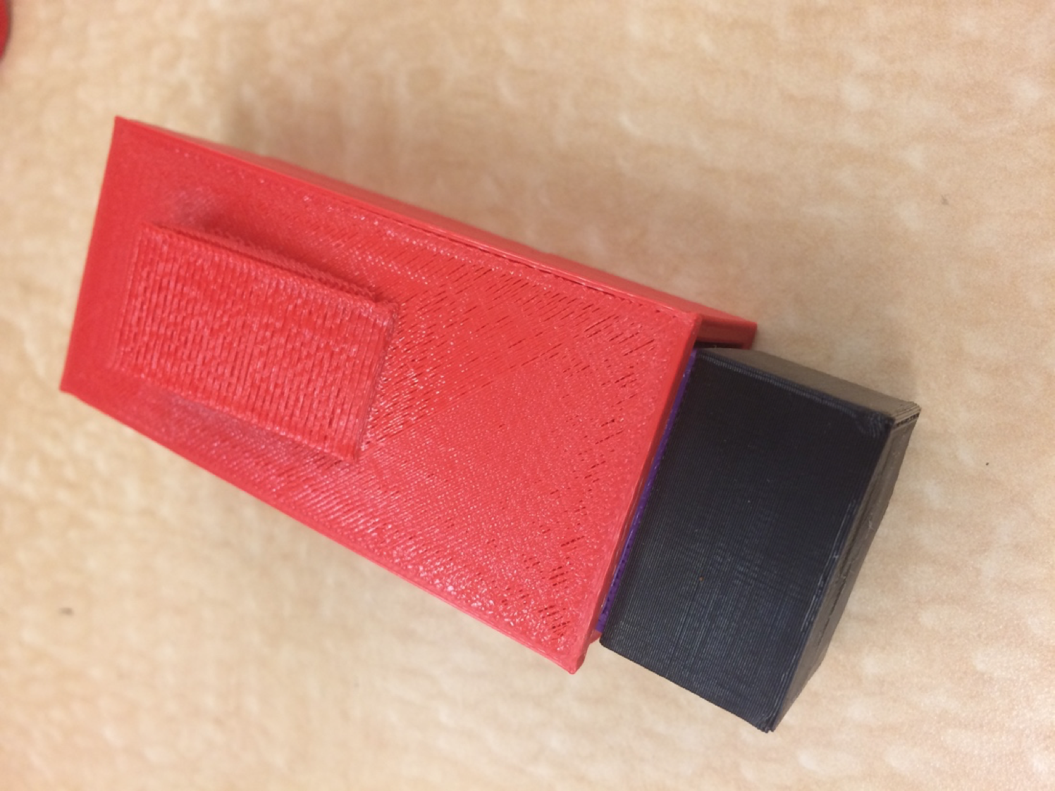
MediSaver: An Epipen Alternative
Vikram Arun, Ben Katzman, Luke Ziolkowski

Slide 2
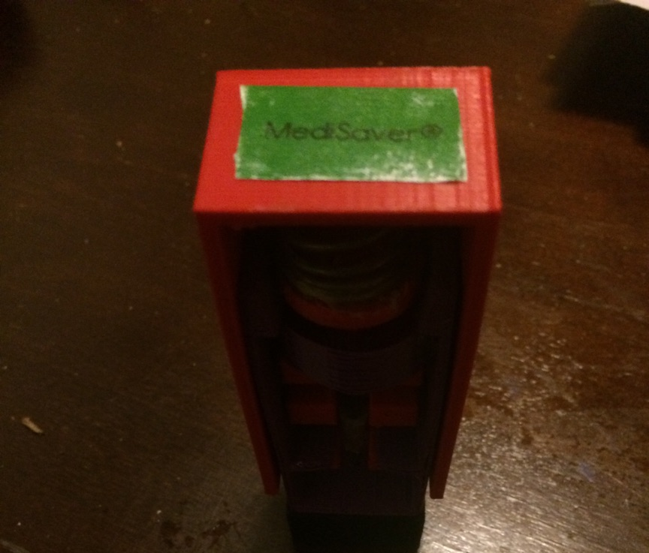
Outline
Project Scope
Design Components
Design Specifications & Testing Results
Demonstration
Future Steps

Slide 3
Project Scope
$4B auto-injector market dominated by Epi-Pen
Propose a more practical, safe, and efficient alternative to deliver Epinephrine in an emergency
Consistent and Reliable
Intramuscular Jet Injector

Slide 4
Outline
Project Scope
Design Components
Design Specifications & Testing Results
Demonstration
Future Steps

Slide 5
Parts List
3D printed pieces (PBA filament): $21.99, amazon.com
(1) Shell
(2) Button
(3) Plunger
(6) Guide
(7) Clip
(8) Cap
Purchased pieces:
(4) Everbilt® Zinc-Plated Compression Spring $3.72, homedepot.com
(5) BD® Syringe 27 Gauge, 1cc, 1/2" Needle $.90/needle, healthwarehouse.com
Left to right: (1) Shell, (2) Button, (3) Plunger, (4) Spring, (5) Syringe, (6) Guide, (7) Clip, (8) Cap
(2) (3) (4) (5) (6) (7) (8)
Notes:
Fix labeling

Slide 6
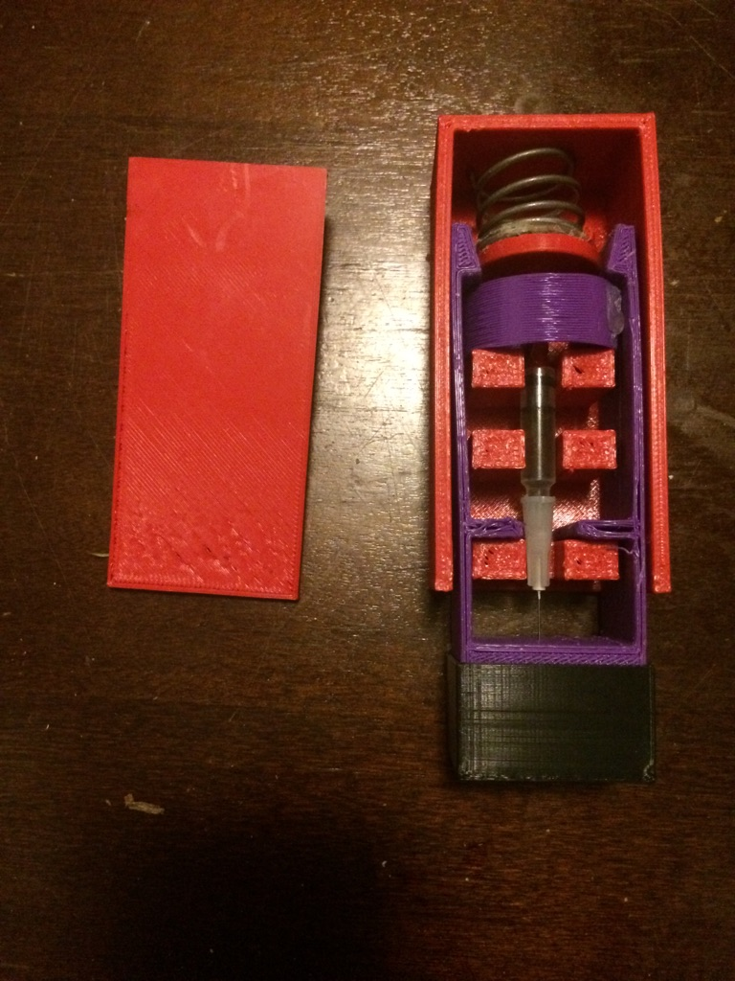
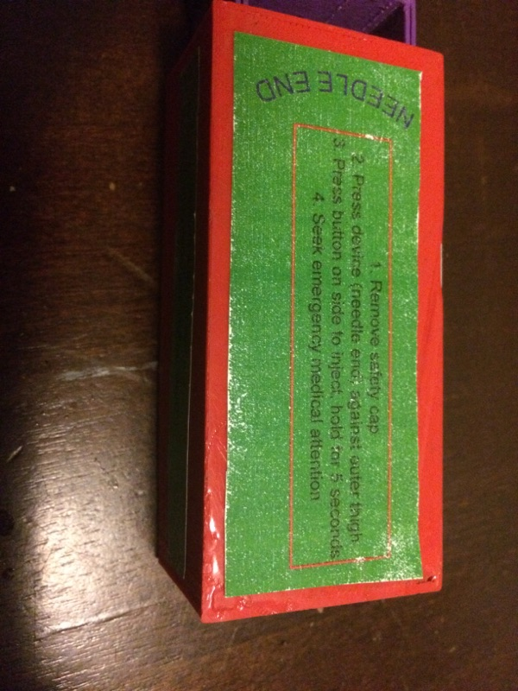
Full Assembly

Slide 7
Outline
Project Scope
Design Components
Design Specifications & Testing Results
Demonstration
Future Steps

Slide 8
Design Specifications
Physical
Usage
Biological
Structure
Miscellaneous

Slide 9
Physical Design Specifications
Weight ( <1 kg)
Portability (<82 cm^3)
Width (< 2.54 cm)
✅ 49.8 grams
✅ 76.2 cm^3
✅ 2.54 cm
Convenient to carry around

Slide 10
Usage Design Specifications
Preparation + Delivery Time
Invasiveness
Application site damage
Delivery Obstacles
Ease of Use
✅ Consistently below 10 seconds to inject
✅ 27 gauge needle
✅ Minimal Damage to Gel
✅ Can be applied with clothes on
✅ Easily administered by a 3rd party
Can be used safely and easily in a multitude of scenarios

Slide 11
Biological Design Specifications
Onset of Absorption
Plasma Concentration over Time
Dosage Accuracy
Dosage Variability
✅
✅
✅
✅ .3 and .15 mg versions
Intramuscular Injection of Epinephrine is Biologically Sufficient

Slide 12
Structural Design Specifications
Force of Activation
Fall Durability
Weight Durability
X Button is sensitive
✅ 2m drop test
✅ 400N
Resilient and Reliable

Slide 13
Miscellaneous Design Specifications
Accident Prevention
Safety after Use
Cost to Produce
Repeatability
Longetivity
Trackability
Clear Instructions
✅ Cap piece to prevent accidental injection
X Needle cannot be retracted
✅ $26.61
X No cartridges, must be disposed of
✅ Durable
✅ Clip-on
✅ Comprehensive Label

Slide 14
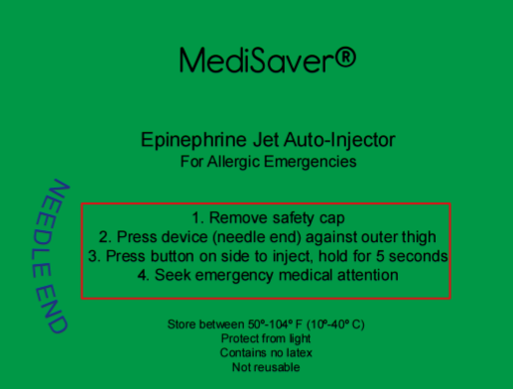
Instructions on Label

Slide 15
Outline
Project Scope
Design Components
Design Specifications & Testing Results
Demonstration
Future Steps

Slide 16
Demonstration

Slide 17
Injection Proof

Slide 18
Outline
Project Scope
Design Components
Design Specifications & Testing Results
Demonstration
Future Steps

Slide 19
Future Goals
Improve the stability of the device
Variable needle lengths or injection pressures for children/adults
Clinical and In Vivo trials with Epinephrine
Explore casing methods to maintain temperature independence for medicant
Test different gauge needles with the same depth and needle length

Slide 20
Acknowledgements
Dr. Klaesner
Darshit Mehta
Professor Widder
Washington University in St. Louis's School of Medicine -- Allergy, Immunology, and Pulmonary Medicine Department
Dr. Horner
Dr. Beigelman
Dr. Kitcharoensakkul

Slide 21
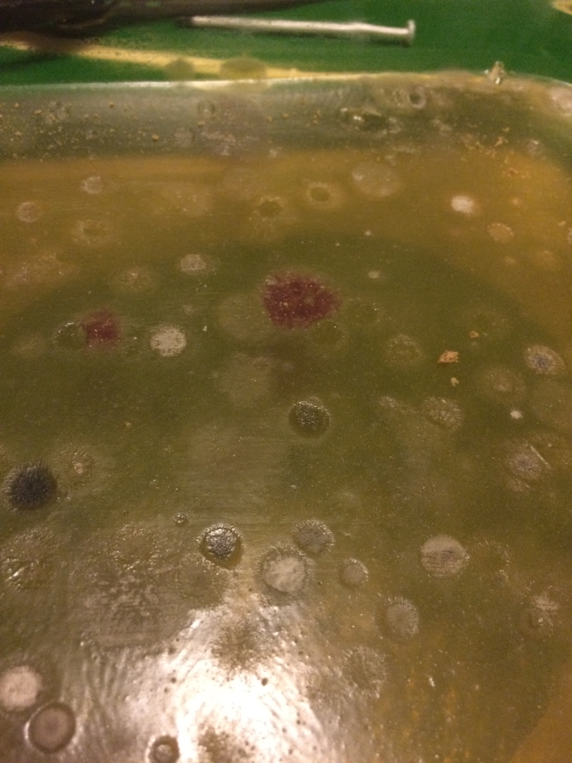
Thanks!
Questions?

